Slide 1


Docker
The Docker Security

Slide 2
Lesson Agenda
Security features of Docker

Slide 3
Introduction
Security is all about layers.
Docker on Linux leverages most of the common Linux security and workload isolation technologies. These include namespaces, control groups (cgroups), capabilities etc. For each one, Docker implements sensible defaults for a seamless and moderately secure out-of-the-box experience. However, you can customize each one to your own specific requirements.

Slide 4
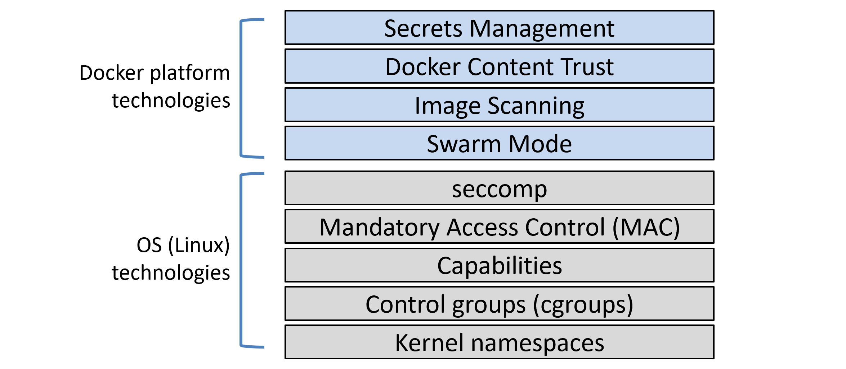

Slide 5
Security features in docker
Docker Swarm Mode is secure by default. You get all of the following with zero configuration required; cryptographic node IDs, mutual authentication, automatic CA configuration, automatic certificate rotation, encrypted cluster store, encrypted networks, and more.
Docker Content Trust (DCT) lets you sign your images and verify the integrity and publisher of images you consume.
Image security scanning analyses images, detects known vulnerabilities, and provides detailed reports.

Slide 6
Namespaces
Kernel namespaces are at the very heart of containers. They slice up an operating system (OS) so that it looks and feels like multiple isolated operating systems.
Namespaces let you run multiple web servers, each on port 443, on a single OS. To do this you just run each web server app inside of its own network namespace. This works because each network namespace gets its own IP address and full range of ports.
You can run multiple applications, each requiring their own version of a shared library or configuration file. To do this you run each application inside of its own mount namespace.
While namespaces isolate multiple processes on a single OS, the isolation they provide is not very strong. For example, namespaces are not as good at workload isolation as virtual machines. You should keep this in mind from a security perspective and not rely too heavily on the isolation provided by namespaces.

Slide 7
Docker on Linux currently utilizes the following kernel namespaces:
Process ID (pid)
Network (net)
Filesystem/mount (mnt)
Inter-process Communication (ipc)
User (user)
UTS (uts)
Docker containers are an organized collection of namespaces.

Slide 8
Overview of docker namespaces
Process ID namespace: Docker uses the pid namespace to provide isolated process trees for each container.
Network namespace: Docker uses the net namespace to provide each container its own isolated network stack.
Mount namespace: Every container gets its own unique isolated root (/) filesystem. This means every container can have its own /etc, /var, /dev and other important filesystem constructs.
Inter-process Communication namespace: Docker uses the ipc namespace for shared memory access within a container. It also isolates the container from shared memory outside of the container.
User namespace: Docker lets you use user namespaces to map users inside of a container to different users on the Linux host.
UTS namespace: Docker uses the uts namespace to provide each container with its own hostname.

Slide 9
Control Groups
control groups (cgroups) are about setting limits.
containers are isolated from each other but all share a common set of OS resources — things like CPU, RAM, network bandwidth, and disk I/O. Cgroups let us set limits on each of these so a single container cannot consume everything and cause a denial of service (DoS) attack.

Slide 10
Capabilities
the Linux root user is a combination of a long list of capabilities. Some of these capabilities include:
CAP_CHOWN: lets you change file ownership
CAP_NET_BIND_SERVICE: lets you bind a socket to low numbered network ports
CAP_SETUID: lets you elevate the privilege level of a process
CAP_SYS_BOOT: lets you reboot the system.
Docker works with capabilities so that you can run containers as root, but strip out all the capabilities you don’t need.
Docker also imposes restrictions so that containers cannot re-add the dropped capabilities.

Slide 11
Security in Swarm Mode
swarm mode includes many security features that are enabled out-of-the-box with sensible defaults. These include:
Cryptographic node IDs
TLS for mutual authentication
Secure join tokens
CA configuration with automatic certificate rotation
Encrypted cluster store (config DB)
Encrypted networks

Slide 12
Docker Secrets
Many applications need secrets — things like passwords, TLS certificates, SSH keys, and more.
Docker 1.13 introduced Docker Secrets as first-class objects in the Docker API.
secrets are encrypted at rest, encrypted in-flight, mounted in containers to in-memory filesystems, and operate under a least-privilege model where they are only made available to services that have been explicitly granted access to them.

Slide 13
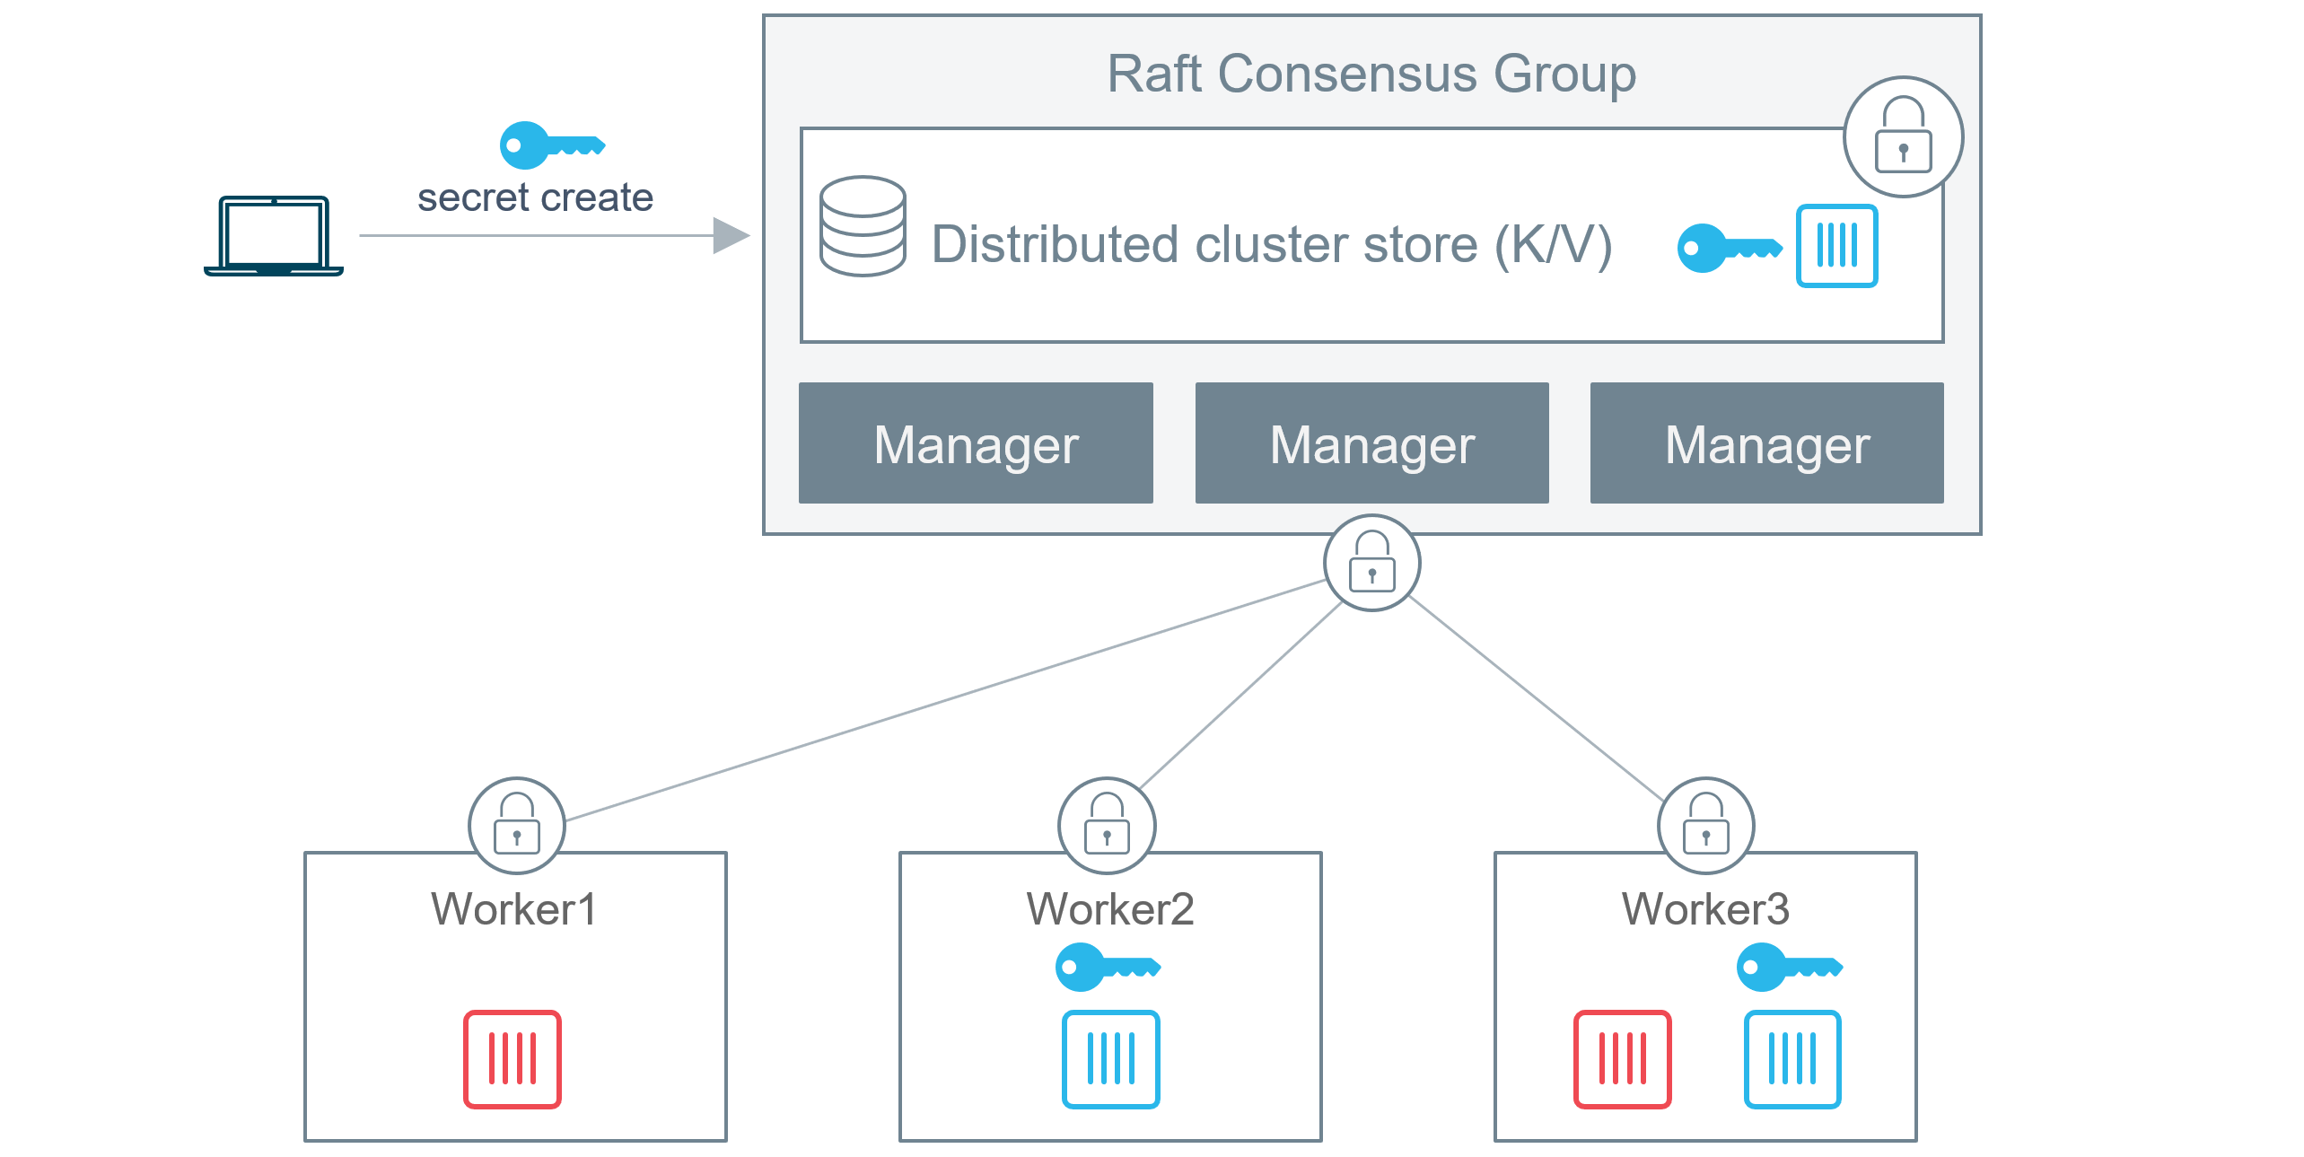

Slide 14
The blue secret is created and posted to the Swarm
It gets stored in the encrypted cluster store (all managers have access to the cluster store)
The blue service is created and the secret is attached to it
The secret is encrypted in-flight while it is delivered to the tasks (containers) in the blue service
The secret is mounted into the containers of the blue service as an unencrypted file at /run/secrets/. This is an in-memory tmpfs filesystem (this step is different on Windows Docker hosts as they do not have the notion of an in-memory filesystem like tmpfs)
Once the container (service task) completes, the in-memory filesystem is torn down and the secret flushed from the node
The red containers in the red service cannot access the secret
The reason that secrets are surfaced in their un-encrypted form in running containers is so applications can use them without requiring methods to decrypt them.
You can create and manage secrets with the docker secret sub-command, and you can attach them to services by specifying the --secret flag to the docker service create command.

